Slide 1


EE448: Server-Side Development
Lecturer: David Molloy
Time: Tuesdays 3pm-5pm
Notes: http://wiki.eeng.dcu.ie/ee448
Mailing List: ee448@list.dcu.ie

Slide 2
EE448: Server-Side Development
Choosing a server-side language
Numerous options for our server-side applications
- Perl, PHP, Java Servlets, JSP, ASP etc.
Some element of choice comes down to personal opinion and familiarity
with languages
However, there are differences, which we will briefly consider
Consider this form: (we want to read values in and print them out)
<HTML>
<HEAD> <TITLE>Form Submission</TITLE> </HEAD>
<BODY> Please enter your details below:
<FORM METHOD="POST" ACTION="http://www.aserver.com/cgi-bin/handle_form.pl">
Firstname: <INPUT TYPE="text" NAME="firstname"></INPUT>
<BR>
Surname: <INPUT TYPE="text" NAME="surname"></INPUT>
<BR>
<INPUT TYPE="SUBMIT">
</BODY> </HTML>

Slide 3
Perl vs PHP
Perl are stand alone applications, which create HTML pages when the script
is executed.
PERL
#! /usr/local/bin/perl
# GET THE INPUT FROM THE CALLING HTML DOCUMENT
read(STDIN, $buffer, $ENV{'CONTENT_LENGTH'});
# Split the name-value pairs
@pairs = split(/&/, $buffer);
foreach $pair (@pairs) {
($name, $value) = split(/=/, $pair);
$value =~ tr/+/ /;
$value =~ s/%([a-fA-F0-9][a-fA-F0-9])/pack("C", hex($1))/eg;
$name =~ tr/+/ /;
$name =~ s/%([a-fA-F0-9][a-fA-F0-9])/pack("C", hex($1))/eg;
$FORM{$name} = $value;
}
# BELOW IS THE BODY OF THE HTML DOCUMENT
print "Hello $FORM{'firstname'} $FORM{'surname'}";

Slide 4
Perl vs PHP
Debatably faster than Perl
Much easier to write than Perl – PHP is the web designers language of choice
Perl is the “ultimate geek language”, originally designed for scripting on
Unix/Linux systems.
PHP more suitable for developing web applications (it’s sole purpose)
PHP much more common than Perl now.
PHP
<?php
print "Hello $firstname $surname";
?>

Slide 5
PHP vs Java
Java consists of Servlets, JSPs, EJBs and a whole range of infrastructure
support
PHP scripts provide no direct support for the management of software
components, client session management, database connection pooling etc.
PHP “tends to” provide poor seperation between presentation logic, business
logic and data management
Java provides us with standards-based patterns, such as
MVC architecture, full object oriented support and management interfaces
to offer best practice development solutions
PHP is easier to get “up and running” – fast and cheap, with little training.
→ #1 language for 1 man websites
As complexity, scale and flexibility of the project increases, PHP’s basic ease
becomes problematic -> need to code extra infrastructure which Java provides by default
Therefore, Java (or .NET) becomes a more suitable solution for large scale
enterprise projects

Slide 6
Java Servlet/JSP Examples
import java.io.*;
import javax.servlet.*;
import javax.servlet.http.*;
public class handleForm extends HttpServlet {
public void doPost(HttpServletRequest request, HttpServletResponse response) throws ServletException, IOException
{
response.setContentType("text/html");
PrintWriter out = response.getWriter();
out.println("Hello " + request.getParameter("firstname") + " " + request.getParameter("surname"));
out.close();
}
}
JSP
Hello <%= request.getParameter("firstname") + " " + request.getParameter("surname") %>

Slide 7
ASP & ASP.NET
ASP stands for Active Server Pages and is a program that runs inside IIS
(Internet Information Services) which is a free component of later Windows versions.
Microsoft Technology which runs on Windows 2000+ (or NT4.0 patched).
ASP files run in much the same way as PHP or JSP files, with scripts embedded into
normal HTML files (with the extension .asp).
Not only are they less platform dependent, but it is widely considered that JSP pages
(and PHP files) are faster and more powerful alternatives.
ASP primarily supports two scripting languages -- JScript and VBScript.
ASP+ (or ASP.NET) is Microsoft's next generation of Active Server Pages.
ASP+ is a complete rework of ASP from the ground up. Part of Microsoft's new .NET
architecture which provides a range of technologies to make development easier for coders.
ASP+ has the benefit of access to compiled languages, such as Visual Basic, C++ and C#.

Slide 8
ASP.NET vs J2EE
It provides increased performance, improved scalability and XML-based components.
NOT fully backward compatible with ASP
In short, while ASP can be used for server-side scripting, it would not be suitable for
large scale enterprise application development. In this situation (and in popular
opinion and practice), there are two main options: .NET and J2EE
.NET and J2EE both provide a range of preexisting functionality to users to ease the
development of large systems.
Which to choose? Up to managers, technical leads etc.
We are going with J2EE

Slide 9
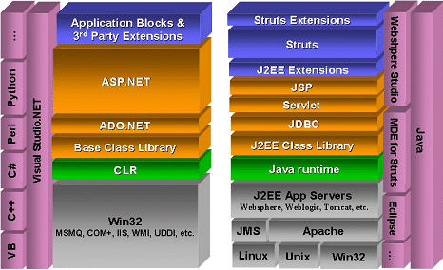
ASP.NET vs J2EE

Slide 10
Java Servlets
JavaSoft (Sun) finalised the concept of Java Servlets in 1997
Servlets are dynamically loaded modules, written in Java, that
service requests from a Web Server.
Java Servlets are programmes written on the server-side,
which are ready to process the tasks for which they are
designed.
Massively popular – replacing PHP, CGI/Perl server-side
scripting
Servlets part of the Java 2 Enterprise Edition (J2EE)
Specification
Implemented on virtually every web/application server

Slide 11
Java Servlets
Portability – written in Java, global APIs, OS/software implementations.
Highly Efficient – servlet is only initialised first time it is loaded -> remains
in the servers memory as an object instance. Subsequent calls -> service()
Persistant – servlets maintain state and stay resident in memory, while
serving incoming requests. Allows holding onto resources such as connection
pooling.
Power - servlets have access to the entire family of APIs dealing with
networking, database connectivity (JDBC), imaging etc.
Note: Java Server Pages (JSPs)
JavaServer Pages (JSPs) are like ‘inside-out’ servlets. Servlets use code
to generate output such as HTML. JSPs are mostly HTML with some code
where dynamic output is required.

Slide 12
Java Servlets
In early stages, we used web servers patched with a servlet engine
such as Apache JServ and later Tomcat
Servlet API Version 2.2 replaced the term ‘servlet engine’ with
‘Servlet Container’
The request/response model for servlets is implemented by the
Servlet Container
Web Servers vs Application Servers – the difference? Web servers more
traditional, patched with various implementations. Application Servers more
fully blown!
Various Servers/Application Servers with Servlet Support – Tomcat,
JBoss J2EE Server, Java Web Server, Allaire Jrun
Tomcat – used as a standalone container (as we use it in module!), or can
be combined with Apache Web Server (Jakarta Open-Source Project)

Slide 13
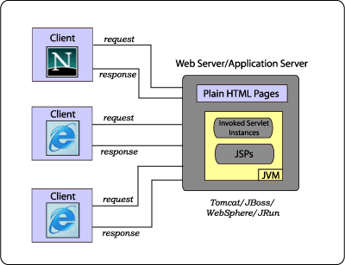
Standalone Servlet Container
Web Server/Application Server with a built-in servlet/JSP container
Client makes a ‘request’ to server, server serves out web page, servlet, JSP etc
output in the form of a ‘response’
Server manages logging, security and other standard web server functions
Most “serious” companies would choose a full blown application server with
database connectivity, EJB, monitoring, performance, advanced security etc.

Slide 14
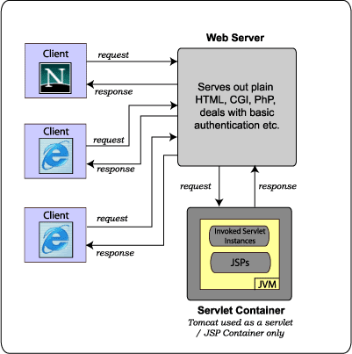
Third-Party Container
Not always practical to replace traditional web server, systems already
in place, legacy PHP, CGI scripts, virtual hosting, satisfactory setup
-> use a traditional web server and ‘plugin’ a servlet/JSP container

Slide 15
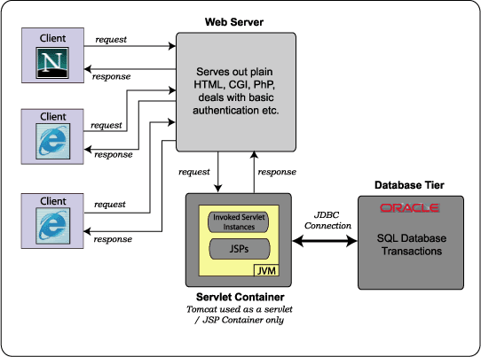
Introducing a Database Tier
Most large scale server-side systems also have a database tier for
persistent data (servlets can hold state but data is not persistent)
Servlet Container communicates with database tier (not the server)
via JDBC
PAD

Slide 16
Hello World Servlet
import java.io.*;
import javax.servlet.*;
import javax.servlet.http.*;
public class HelloWorld extends HttpServlet {
public void doGet(HttpServletRequest request, HttpServletResponse response)
throws ServletException, IOException {
response.setContentType("text/html");
PrintWriter out = response.getWriter();
out.println("<HTML><HEAD><TITLE>Hello World</TITLE></HEAD>");
out.println("<BODY><H1>Hello World!</H1></BODY></HTML>");
out.close();
}
}
doGet() method handles a GET method request - doPost() and service()
This servlet extends the HttpServlet class and overloads the doGet()
method inherited from it
Each time a GET request for this servlet is received, the server invokes
the doGet() method, passing it a HttpServletRequest object and
HttpServletResponse object

Slide 17
Deploying Your Servlet
Three main stages involved in deploying a servlet
Servlet should be saved as a .java file and compiled using:
javac HelloWorld.java
Need access to the Servlet API to compile – included in J2EE or Tomcat
Compiled class file need to be deployed in the Servlet Container
Test the servlet using a URL such as:
http://localhost:8080/student/servlet/HelloWorld
URL used is dependent on container setup and “context”

Slide 18
Servlets in Eclipse
Preferred development IDE for this module
Available on all Masters machines and during the examinations
Requires installation of J2SE
Sysdeo Plugin
Demonstration of deploying servlets in Eclipse/Sysdeo

Slide 19
Tomcat
Tomcat is our Servlet Container of choice for the module
Tomcat is the official reference implementation for the Java Servlet
and JSP technologies
Tomcat is open source, released under the Apache Software License
Local Machines: Installation and all configuration is copied to
C:\temp\tomcat
If you create a new Tomcat project in Eclipse and add a servlet in the
correct place in the web application, save and reload Tomcat:
http://localhost:8080/student/servlet/ServletName

Slide 20
Additional Installation Information
For home installations, some changes are required for general
servlets (2) and for SSI include examples (3)
For servlets in general, we wish to set up the /servlet/ mapping
-> we edit the TOMCAT_HOME/conf/web.xml file
For SSI we also modify the web.xml file
Additionally, we need to rename TOMCAT_HOME/server/lib/….
servlets-ssi.renametojar to servlets-ssi.jar

Slide 21
Web Application Structure
Servlet/JSP Containers that conform to the Servlet API 2.2 Specification
and upwards must accept a ‘Web Applicaton Archive’ as a format
A Web Application is a collection of servlets, JSPs, HTML pages, classes
and other resources bundled together in a standard format
A Web Application is defined within a WAR file (Web Archive)
Can deploy and run a WAR across multiple 2.2 compliant servers
WAR files created using the JAR command (actually same as a .jar)
jar –cf student.war *
Web Application consists of:
- Servlets - JSPs
- Utility Classes - Static Documents (html, css etc)
- Client Side Applets and JavaBeans
- A deployment descriptor and information about the application

Slide 22
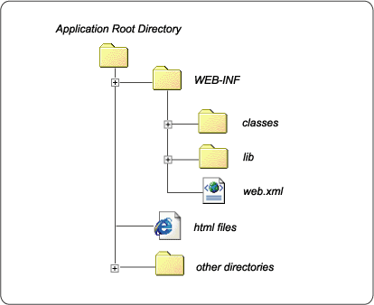
Web Application Structure
Unpacked Format – during development
WAR more typically used for deployment
Root = HTML, Image, CSS, JSPs
WEB-INF contains various resources. Not part of the public document
web.xml = Web Application Deployment Descriptor
lib – contains JAR or ZIP files that the application needs
classes – servlets, class files

Slide 23
Deployment Descriptor – web.xml
Web Application Deployment Descriptor = Text XML properties file
Defines configuration information for the Web Application
- Servlet/JSP Definitions
- Servlet/JSP Mappings
- Welcome file list (index.html, index.jsp etc)
- Security and Authentication
- Initialization Parameters
- Session Configuration
- Error Pages
- MIME Types

Slide 24
Deployment Descriptor Snippet
<web-app>
<display-name>Sample Web Application</display-name>
<session-timeout>30</session-timeout>
<servlet>
<servlet-name>SampleServlet</servlet-name>
<servlet-class>com.dcu.SampleServlet</servlet-class>
<load-on-startup>1</load-on-startup>
<init-param>
<param-name>ServletParamName</param-name>
<param-value>ServletParamValue</param-value>
<description>A initialization parameter passed this servlet</description>
</init-param>
</servlet>
</web-app>

Slide 25
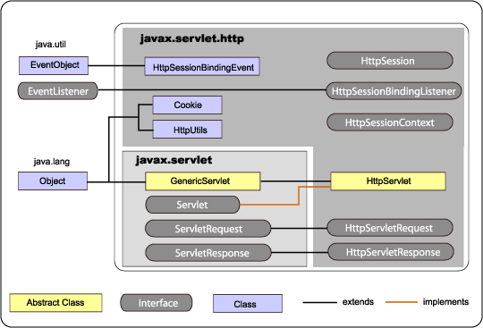
Servlet API
Servlet API defines a standard interface for handling request/response
Composed of two packages:
- javax.servlet contains classes to support generic, protocol-independent servlets
- javax.servlet.http extends javax.servlet to add HTTP-specific functionality
Also, provides classes which deal with HTTP-style cookies and session tracking

Slide 26
Servlet API
Every servlet must implement the javax.servlet.Servlet interface
Two main types of classes which implement the servlet interface:
- javax.servlet.GenericServlet : Servlets that extend this class are protocol
independent. They do not contain any support for HTTP or other protocols
- javax.servlet.HttpServlet : Servlets that extend the HttpServlet class
have built in support for HTTP protocol
Always implementing the HttpServlet interface
javax.servlet package specifies two exception classes
- javax.servlet.ServletException – general exception for servlet errors
- javax.servlet.UnavailableException – servlet is unavailable

Slide 27
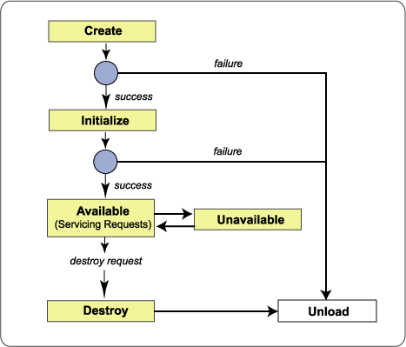
Servlet Life Cycle
A servlet is constructed and initialized
It services zero or more requests
Server shuts down, servlet is destroyed and garbage is collected

Slide 28
Initialization
Servlet Container loads servlets either at server startup (pre-loading)
or when they are accessed first time (dynamically)
Most containers/application servers allow specifying which are loaded
at startup (see the web.xml snippet)
init(ServletConfig) method is called by server when server constructs the
servlet’s first instance. Guaranteed called first!
public void init(ServletConfig config) throws ServletException
{
super.init(config);
}
ServletConfig object supplies a servlet with information about its
initialization parameters
super.init(config) should be called to ensure parent’s init() method is called

Slide 29
Service
service() method handles all requests sent by a client (after init())
Servlet container calls the service() method to handle requests and to write
the formatted response back to the client
Container constructs a request object out of the request as
ServletRequest (generic) or HttpServletRequest (HTTP)
Container constructs a response object to format the response
ServletResponse (generic) or HttpServletResponse (HTTP)
public void service(HttpServletRequest req, HttpServletResponse res)
throws ServletException, IOException
Default implementation of service() method has code to automatically redirect
HTTP requests such as GET and POST to methods such as doGet() and doPost
-> Implement service method for GenericServlet, otherwise don’t!

Slide 30
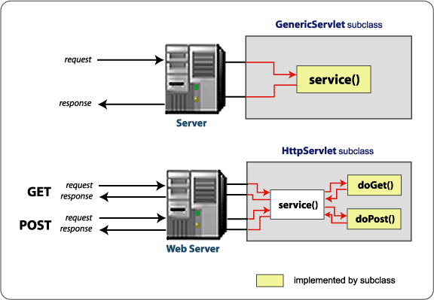
Service

Slide 31
Destruction
Servlet Container stops a servlet by invoking the destroy() method
of the servlet interface
You can override the destroy() method to release resources such as
database connections
Any persistent information should be stored during this method or it
will be lost!
public void destroy()
Java -> don’t need to actually free up memory from arrays, Vectors
variables etc.

Slide 32
Tomcat Manager Application
Demonstrate the Tomcat Manager Application
Deployment Steps
Write the source code
Compile the source code, creating a class file (using servlet.jar)
or select ‘Save’ in Eclipse
Copy class file to the classes directory (auto in Eclipse)
Make changes to the deployment descriptor (if necessary)
Startup Tomcat or use the Manager to startup/reload the Web App.

Slide 33
ServletContext
ServletContext lives within the Web Application Structure
Only one ServletContext per Web Application per JVM
Servlets within same ServletContext have access to shared resources,
information and non-private methods
Context rooted at a specified path … eg. /student
Context is defined within the Web Application deployment descriptor
web.xml file.
ContextExample.java
Demonstrate how methods can obtain initializaton parameters
public String getInitParameter(String name)
or
public Enumeration getInitParameterNames()

Slide 34
ContextExample.java
import java.io.*;
import javax.servlet.*;
import javax.servlet.http.*;
public class ContextExample extends HttpServlet
{
public void doGet(HttpServletRequest request, HttpServletResponse response)
throws ServletException, IOException
{
response.setContentType("text/html");
PrintWriter out = response.getWriter();
// Grab the Parameters from the web.xml file
String fn = getInitParameter("firstname");
String ln = getInitParameter("lastname");
out.println("<HTML><HEAD><TITLE>Context Init Params</TITLE></HEAD>");
out.println("<BODY><H1>Hello ");
out.println(fn + " " + ln + "</H1></BODY></HTML>");
out.close();
}
}

Slide 35
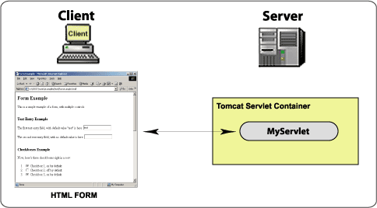
Form Data Servlets
HTML is our Graphical User Interface (GUI) for a servlet (not awt)

Slide 36
Form Example (using GET)
<html>
<head>
<title>Basic Format</title>
</head>
<body>
<H2>Please fill out this form:</H2>
<FORM METHOD="GET" ACTION="http://localhost:8080/student/servlet/FormServlet"
name="myform">
<BR>Firstname: <INPUT NAME="firstname">
<BR>Surname: <INPUT NAME="surname">
<BR>Age: <INPUT NAME="age">
<BR>
<INPUT TYPE="submit" value="Submit Form">
<INPUT TYPE="reset" value="Reset">
</FORM> ← Note </FORM> was missing in the notes
</body>
</html>

Slide 37
FormServlet.java (using GET)
import java.io.*;
import javax.servlet.*;
import javax.servlet.http.*;
public class FormServlet extends HttpServlet
{
public void doGet(HttpServletRequest req, HttpServletResponse res)
throws ServletException, IOException
{
res.setContentType("text/html");
PrintWriter out = res.getWriter();
out.println("<HTML><HEAD><TITLE>Form Example</TITLE></HEAD>");
out.println("<BODY><H1>Hello " + req.getParameter("firstname") + " "
+ req.getParameter("surname") + "</H1>");
out.println("You are " + req.getParameter("age") + " years old!");
out.println("</BODY></HTML>");
out.close();
}
}

Slide 38
Form Example 2 (using POST)
<html>
<head>
<title>Basic Format</title>
</head>
<body>
<H2>Please fill out this form:</H2>
<FORM METHOD=“POST" ACTION="http://localhost:8080/student/servlet/FormServlet2"
name="myform">
<BR>Firstname: <INPUT NAME="firstname">
<BR>Surname: <INPUT NAME="surname">
<BR>Age: <INPUT NAME="age">
<BR>
<INPUT TYPE="submit" value="Submit Form">
<INPUT TYPE="reset" value="Reset">
</FORM> ← Note </FORM> was missing in the notes
</body>
</html>

Slide 39
FormServlet2.java (using POST)
import java.io.*;
import javax.servlet.*;
import javax.servlet.http.*;
public class FormServlet2 extends HttpServlet
{
public void doPost(HttpServletRequest req, HttpServletResponse res)
throws ServletException, IOException
{
res.setContentType("text/html");
PrintWriter out = res.getWriter();
out.println("<HTML><HEAD><TITLE>Form Example</TITLE></HEAD>");
out.println("<BODY><H1>Hello " + req.getParameter("firstname") + " "
+ req.getParameter("surname") + "</H1>");
out.println("You are " + req.getParameter("age") + " years old!");
out.println("</BODY></HTML>");
out.close();
}
}
Demonstrate Bookmarking/Hidden URL

Slide 40
Self-Learning Example
Write a Form which takes two integer numbers (a and b). Write a
servlet which will output:
- a multipled by b
- a minus b
- a plus b
Optionally, you could perform either JavaScript or server-side checking
on the parameters to make sure that they are legal values (ie. Integer
numbers)
Show self-learning Numbers.java in action

Slide 41
Server-Side Includes
A server-side include (SSI) enables you to embed a Java servlet within
an HTML document
Web/Application Servers often allow pages to be preprocessed by the
server to include output from one or more servlets within a html page
Special tags, which are extensions to the HTML language are placed
within a file with a .shtml extension
Servlet is written and compiled
Special tags are placed in the HTML file where dynamic output needed
File is saved as a .shtml file
When client requests a .shtml file, server recognises special type,
passes it to a server application to parse the document and execute
the servlet code where applicable
Results of servlet applications merged with HTML doc and viewed
by the client in the standard way -→ client sees normal HTML

Slide 42
Server-Side Includes
Work through the example GetTime.java
Directly called as a Servlet
http://localhost:8080/student/servlet/GetTime
Called within a Server-Side Include (.shtml) file
<!--#include virtual="/student/servlet/GetTime?format=long" -->
<!--#include virtual="/student/servlet/GetTime?format=short" -->
View gettime.shtml
Some application servers/containers use <SERVLET> tags
These tags are not a standard
-> We use the standard Apache/NSCA tags as shown above

Slide 43
Self-Learning (SSI)
Write a basic counter servlet, which increments every time it is used on
a page. Include it on a basic page (which you also write), deploy them
both on a server and refresh the page a number of times to watch the
counter increase.
What is the problem with a counter like this?

